Slide 1
Chapter 1
Continuous-time
Signals and Systems

Slide 2
Introduction
Any problems about signal analyses and processing may be thought of letting signals trough systems.
f(t)
y(t)
h(t)
From f(t) and h(t)，find y(t)， Signal processing
From f(t) and y(t) ，find h(t) ，System design
From y(t) and h(t)，find f(t) ， Signal reconstruction

Slide 3
Introduction
There are so many different signals and systems that it is impossible to describe them one by one
The best approach is to represent the signal as a combination of some kind of the simplest signals which will pass through the system and produce a response. Combine the responses of all simplest signals, which is the system response for the original input signal.
This is the basic approach to study the signal analyses and processing.

Slide 4
Continue-time Signal
All signals are thought of as a pattern of variations in time and represented as a time function f(t).
In the real-world, any signal has a start. Let the start as t=0 that means
f(t) = 0 t<0
Call such signals causal.

Slide 5
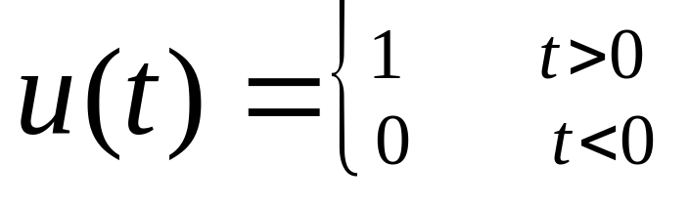
Typical signals and their representation
Unit Step u(t) (in our textbook μ(t))
u(t)
u(t- t₀)
1
1
0
t
0
t₀
t
u(t) is basic causal signal, multiply which with any non-causal signal to get causal signal.

Slide 6
Typical signals and their representation
Sinusoidal A sin(ωt+φ)
f(t) = A sin(ωt+φ)= A sin(2πft+φ)
A - Amplitude
f – frequency (Hz, cycle per second)
ω= 2πf angular frequency (radians/sec)
φ – start phase(radians)

Slide 7
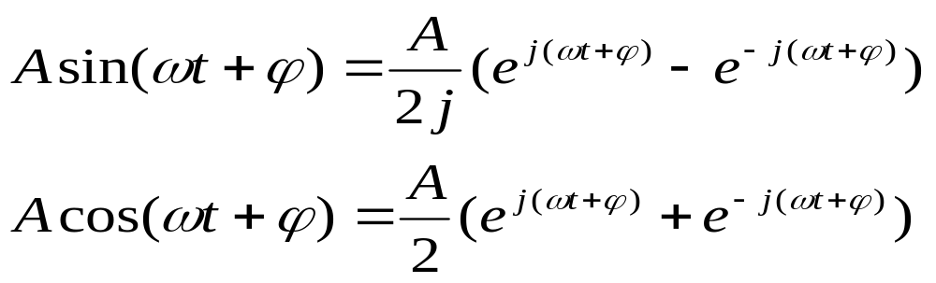
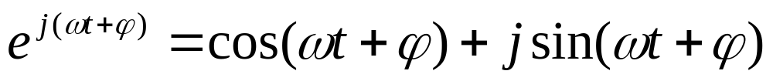
Typical signals and their representation
sin/cos signals may be represented by complex exponential
Euler’s relation

Slide 8
Typical signals and their representation
Sinusoidal is basic periodic signal which is important both in theory and engineering.
Sinusoidal is non-causal signal. All of periodic signals are non-causal because they have no start and no end.
f (t) = f (t + mT) m=0, ±1, ±2, ···, ±∞

Slide 9
Typical signals and their representation
Exponential f(t) = e^{αt}
α is real
α < 0 decaying
α = 0 constant
α > 0 growing

Slide 10
Typical signals and their representation
Exponential f(t) = e^{αt}
α is complex α = σ + jω
f(t) = Ae^{αt} = Ae^{(σ + jω)t}
= Ae^{σ t} cosωt + j Ae^{σ t} sinωt
σ = 0, sinusoidal
σ > 0 , growing sinusoidal
σ < 0 , decaying sinusoidal (damped)

Slide 11
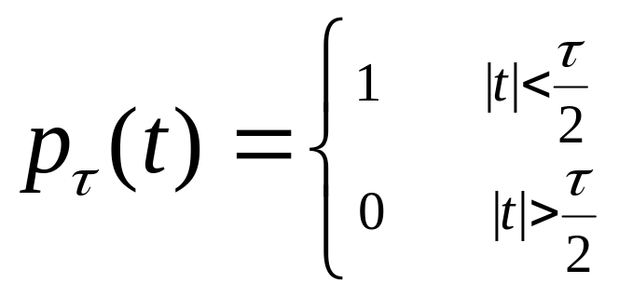
Typical signals and their representation
Gate signal
1
-τ/2
τ/2
The gate signal can be represented by unit step signals:
P_{τ}(t) = u(t + τ/2) – u(t – τ/2)

Slide 12
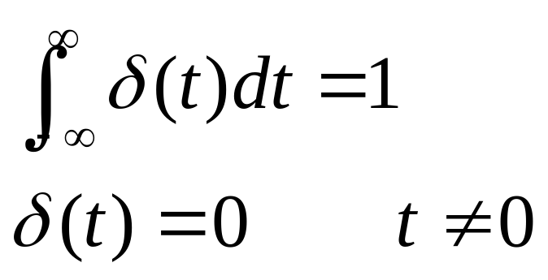
Typical signals and their representation
Unit Impulse Signal
δ(t) is non-zero only at t=0，otherwise is 0
δ(t) could not be represented by a constant even at t=0，but by an integral.
Regular function has exact value at exact time. Obviously，δ(t) is not a Regular function, but Singularity function（or Generalized function).

Slide 13
Unit impulse function δ(t)
With a gate signal p_{τ}(t), short the duration τ and keep the unit area
4/τ
2/τ
1/τ
1/τ
-τ/2
τ/2
-τ/4
τ/4
-τ/8
τ/8
When τ→0, the amplitude tends to ∞, which means it is impossible to define δ(t) by a regular function.

Slide 14
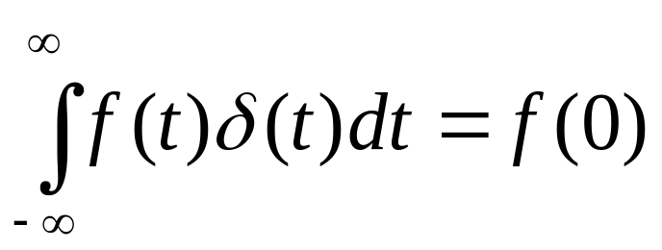
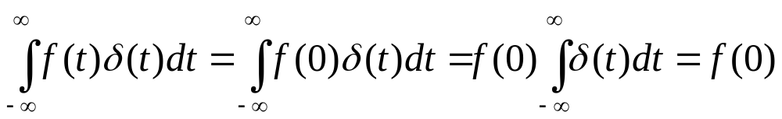
Properties of δ(t)
Sampling Property
Briefly understanding：
When t ≠ 0, δ(t)=0, then f(t)·δ(t)=0
When t = 0, f(t) = f(0) is a constant. Based on the definition of δ(t), it is easy to get:

Slide 15
Properties of δ(t)
δ(t) shift
δ(t)
δ(t-τ)
0
t
0
τ
t
δ(t) times a constant A:
Aδ(t)
A is called impulse intension which is the area of the integral

Slide 16
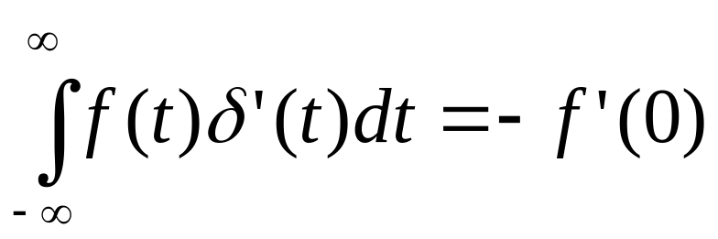
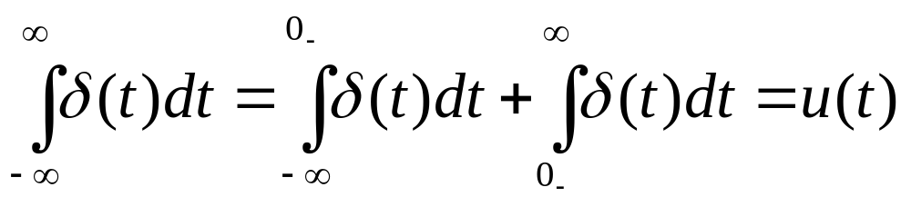
Properties of δ(t)
Differential of δ(t) is also an impulse
δ’(t) = dδ(t)/dt and
Integral of δ(t) is unit step signal:

Slide 17
Properties of δ(t)
δ(t) is a even function, that is
δ(t) = δ(-t)
We got δ(t) from a gate signal, and gate signal is an even function. It is also easy to give the math show of the even property.

Slide 18
Signal representation based on δ(t)
Any signal can be represented by a sum of shifted and weighted δ(t)
f(t)
kΔτ
Approximate f(t) with a serial of rectangles. For the rectangle near t=kΔτ , the duration is Δτ, the height is f(kΔτ), and the area is f(kΔτ) Δτ . So the rectangle can be represented by f(kΔτ) Δτδ(t - kΔτ).

Slide 19
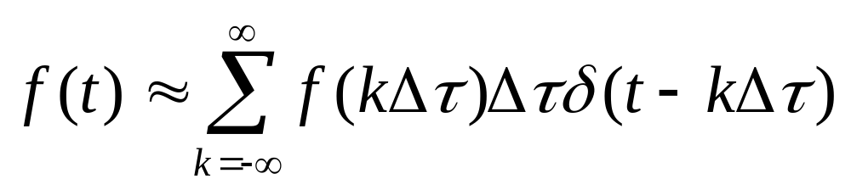
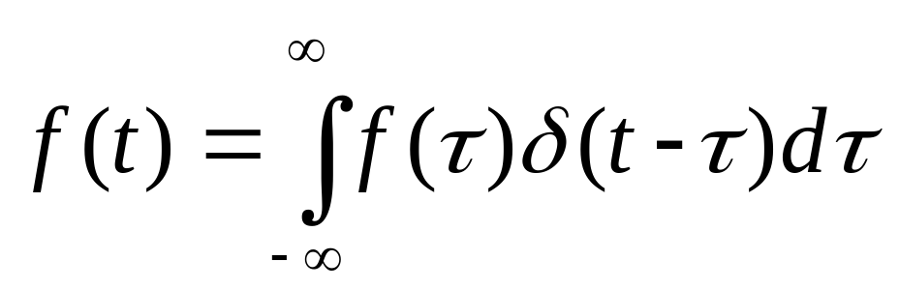
Signal representation based on δ(t)
f(t) can be approximated as follows:
The smaller of Δτ, the higher of the accuracy, and when Δτ→dτ, k Δτ →τ, the above expression becomes precision representation:

Slide 20
Linear time-invariant system
Input signal f(t) into system, output y(t):
f(t) → y(t)
f(t)
y(t)
If satisfy
af(t) → ay(t) and f₁(t) + f₂(t) → y₁(t)+ y₂(t)
Scaling additivity
That is af₁(t) +b f₂(t) → ay₁(t)+ by₂(t)
The system is called linear.

Slide 21
Linear time-invariant system
If satisfy
f(t – t₀) → y(t – t₀)
The system is called time-invariant.
The reason to study linear time-invariant system is that based on δ(t) shifted and weighted sum representation of f(t), we can only discuss the system response for unit impulse, then make the sum of responses for all shifted and weighted impulses to get the whole response. It can be done only with linear time-invariant systems.

Slide 22
System unit impulse response
The system response for unit impulse δ(t) is called system unit impulse response, and denoted as h(t)
δ(t)
h(t)
h(t) is important figure of linear time-invariant system. It can be done to get response for any input signal based on h(t), because any signal can be represented as a sum of shifted and weighted δ(t).

Slide 23
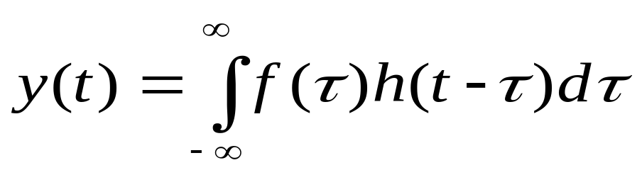
Signal pass through linear time-invariant system
δ(t) →h(t)
aδ(t – t₀) → ah(t – t₀)
Denote y(t) = f(t) * h(t), which is called convolution of f(t) and h(t)

Slide 24
Frequency domain analyses of continue-time
signals and systems

Slide 25
Analyses in time domain and frequency domain
With the time domain analyses, signals are decomposed the sum of shifted and weighted δ(t) , and only system response for δ(t) is attracted attention.
With the frequency domain analyses, signals are decomposed the sum of fundamental sinωt and harmonious, and the system response for sinωt could be attracted attention only.

Slide 26
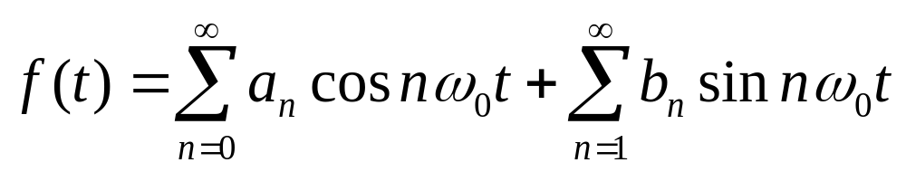
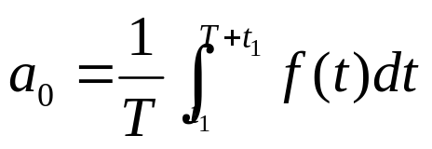
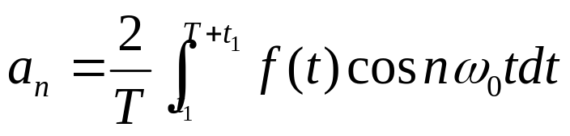
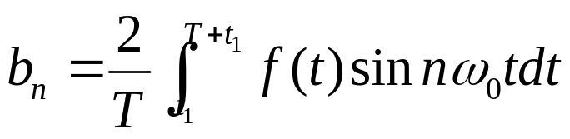
Fourier series of periodic signals
Periodic signals is expanded to Fourier series
The average in one period

Slide 27
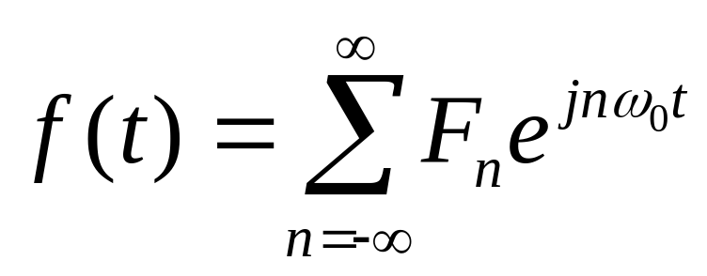
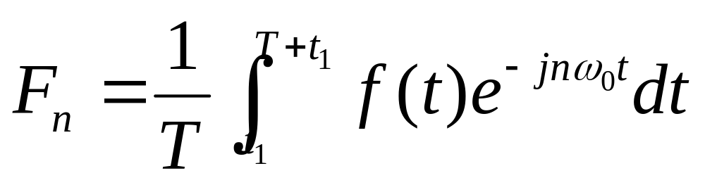
Fourier series of periodic signals
Fourier series in exponential form

Slide 28
Spectrum of periodic signals
Periodic rectangles with period T, duration τ, and amplitude A:
f(t)
A
-T
- τ/2
τ/2
T
t

Slide 29
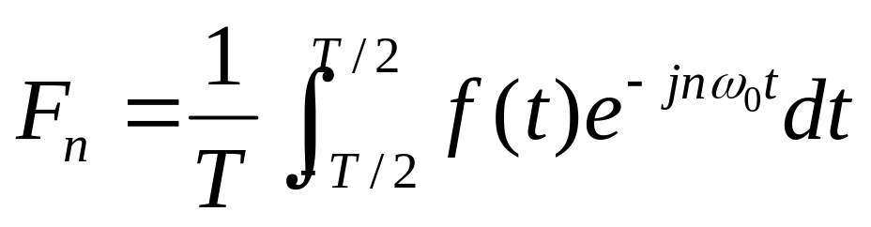
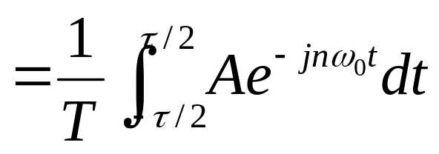
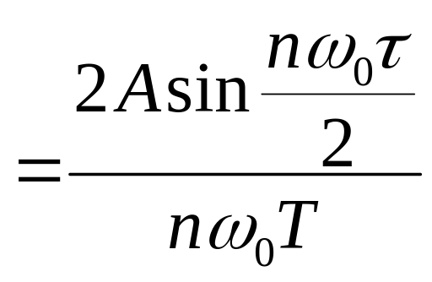
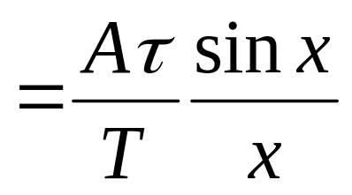
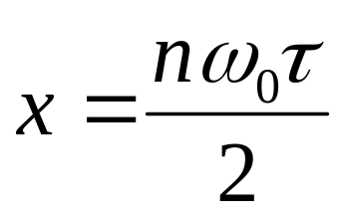
Periodic signals is expanded to Fourier series

Slide 30

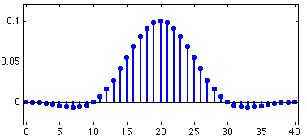
Sampling function Sa(x) = sinx/x
F_{n} = (Aτ/T)Sa(nω₀ τ /2)

Slide 31
Fourier analyses of non-periodic signals—Fourier Transform
When the period of a periodic signal is expanded to ∞, the signal is becoming non-periodic:
ω₀= 2π/T
But T→ ∞ , F_{n} and ω₀ → 0，the amplitude of lines and the distance between lines tend to 0. It is unreasonable to describe the signal with frequency lines. So the concept of spectrum density is introduced.

Slide 32
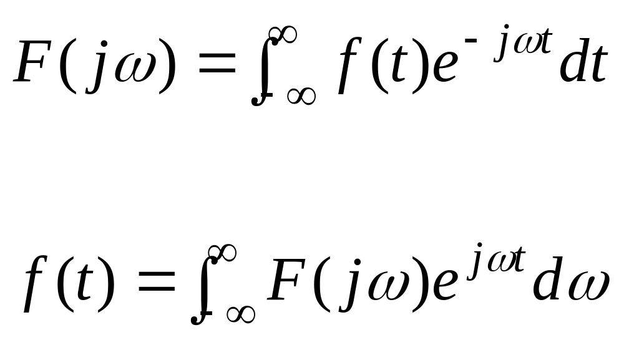
Fourier Transform pair

Slide 33
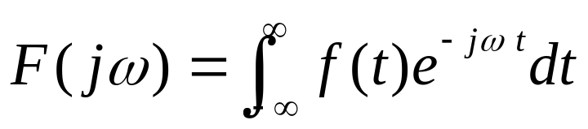
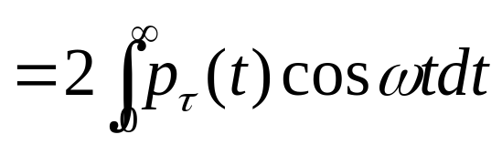
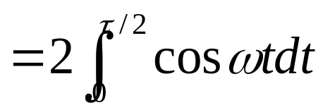
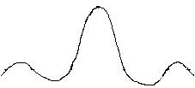
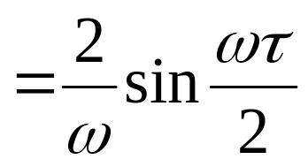
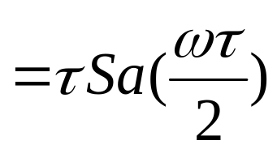
Fourier Transform of typical signals
Gate
1
-τ/2
τ/2
F(jω)
τ
2π/ τ
4π/ τ
ω

Slide 34
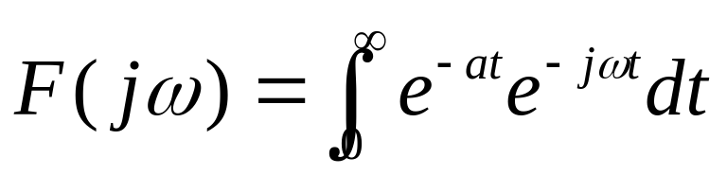
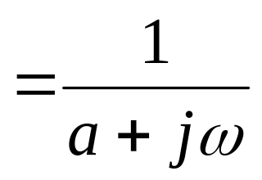

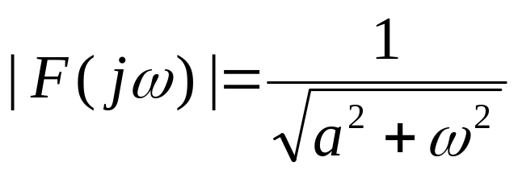

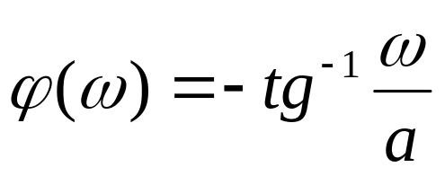
Fourier Transform of typical signals
Exponential f(t) = e^{-at} u(t) a>0
e^{-at} u(t)
t
|F(jω)|
1/a
ω

Slide 35
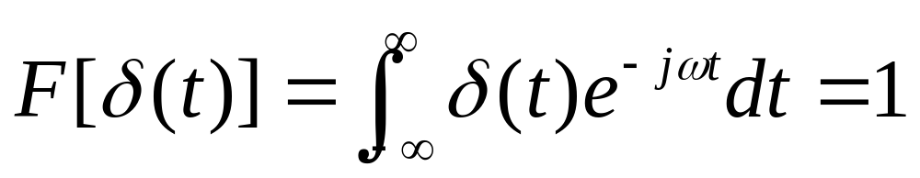
Fourier Transform of typical signals
Unit impulse δ(t)
δ(t)
|F(jω)|
1
0
t
0
ω
Unit impulse has uniform frequency density in whole frequency range, that means it has infinite wide band.

Slide 36
Fourier Transform of typical signals
Constant 1
1 ←→ 2πδ(ω)
This result could be got directly based on the symmetry of Fourier Transform.
Constant 1 represents direct current signal, and its spectrum is non-zero only at ω = 0, which is a δ(ω)

Slide 37
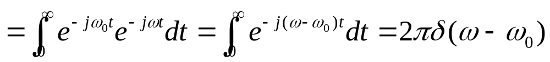
Fourier Transform of typical signals
Sin and cos function
Based on the transform pair 1 ←→ 2πδ(ω) and δ(t) ←→ 1, we have some important conclusions:
F[e^{jω0t}]
F[cosω₀t]= F[(e^{jω0t} + e^{-jω0t)}/2]= π[δ(ω + ω₀)+ δ(ω - ω₀)]
F[sin ω₀t]= F[(e^{jω0t} - e^{-jω0t)}/2j]= jπ[δ(ω+ ω₀)- δ(ω - ω₀)]
F[cos ω₀t]
F[sin ω₀t]
(π)
(π)
(jπ)
ω₀
-ω₀
ω₀
-ω₀
(-jπ)

Slide 38
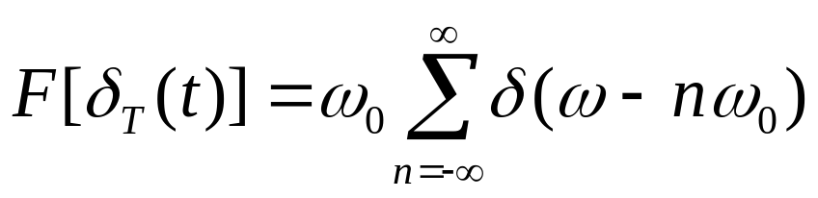
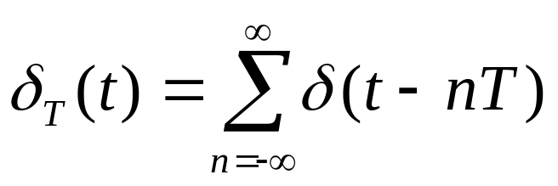
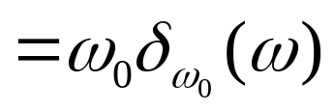
Fourier Transform of typical signals
Unit impulse sequence
δ_{T}(t)
ω₀δ_{ω0}(ω)
-2T
-T
0
T
2T
t
-2ω₀
- ω₀
0
ω₀
2ω₀
ω
ω₀ = 2π/T

Slide 39
Properties of Fourier Transform
Linear
Fourier Transform is an integral, and it is a linear operation:
If f₁(t) ←→ F₁(jω) f₂(t) ←→ F₂(jω)
Then af₁(t) + bf₂(t) ←→ aF₁(jω) + bF₂(jω)

Slide 40
Properties of Fourier Transform
Time shift
Signal’s shift in time domain equals phase shift in frequency domain
f (t - t₀) ←→ F(jω)e^{-jωt0}
Based on the definition of Fourier Transform, the above result is easy to be shown.

Slide 41
Properties of Fourier Transform
Frequency shift(Modulation theorem)
Modulate carrier sinω₀t with base band signal f(t)
Based on definition of Fourier Transform:
f(t)e^{jω0t} ←→ F[j(ω – ω₀)]
With Euler’s relation, it is easy to show:
f(t) cosω₀t = 1/2 f(t) (e^{jω0t} +e^{-jω0t} )
f(t) cosω₀t ←→ 1/2 {F[j(ω + ω₀)]+ F[j(ω – ω₀)]}
f(t) sinω₀t ←→ j/2 {F[j(ω + ω₀)]- F[j(ω – ω₀)]}

Slide 42
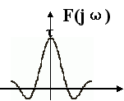
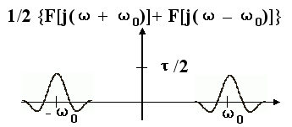
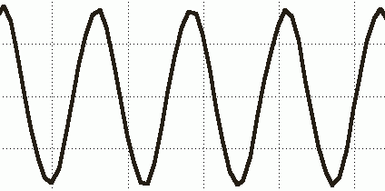
Spectrum of amplitude modulation
P_{τ}(t)
1
←→
-τ/2
τ/2
P_{τ}(t) cosω₀t
←→

Slide 43
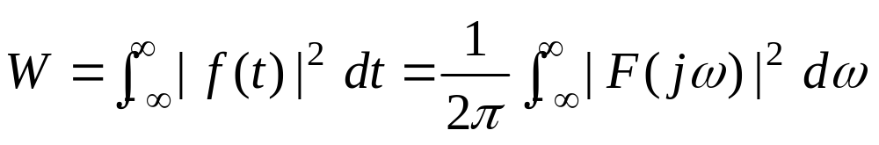
Properties of Fourier Transform
Energy theorem
It is called Parseval’s relation.
W is energy of signal, |F(jω)|² named signal energy spectrum is signal energy in unit frequency band that has similar shape with |F(jω)|, but no phase information.

Slide 44
Properties of Fourier Transform
Convolution theorem
convolution theorem in time domain
f₁(t)*f₂(t) ←→F₁(jω) F₂(jω)
convolution theorem in frequency domain
f₁(t) f₂(t) ←→1/(2π)[F₁(jω) *F₂(jω)]

Slide 45
Properties of Fourier Transform
Transfer the convolution operation in one domain to the algebra operation in another domain. Almost all of the properties discussed above could be shown based on the convolution theorem
Time shift:
f (t - t₀) = f (t )*δ(t - t₀) ←→ F(jω)e^{-jωt 0}
Frequency shift:
f(t)e^{jω0t} ←→ 1/(2π)[F[j(ω )* 2πδ(ω - ω₀)]=F[j(ω – ω₀)]

Slide 46
Fourier analyses of linear system
f(t)
h(t)
H(jω)
y(t)
F(jω)
Y(jω)
y(t) = f(t) * h(t)
Y(jω) = F(jω) H(jω)
H(jω) is called system function, or transfer function

Slide 47
Fourier analyses of linear system
Spectrum analyses is an active research area today. If system is too complicated to be represented by analytical expression, it could be done that input sin signals with different frequencies and measure the system output, then give the system transfer function.
That is called frequency sweep

